Slide 1


Used Hyundai Car Price Prediction
Presented by:
Ayush Chourasiya
Akash Phatangare
Priyanka Chaurasia
Rohit Jadhav

Slide 2


INTRODUCTION
With the help of Machine Learning model we have Predicted the used Hyundai car prices in UK including various Influential Factors such as Model, Year, Mileage, Fuel type, Engine Size which significantly impact the prices of used cars.
OBJECTIVES
Accurate price predictions for the buyers to make informed decisions by evaluating the fairness of asking prices and for Sellers they can set appropriate prices based on market trends, which increasing their chances of a successful sale.
This project aims to contribute to the understanding of used car pricing dynamics by analyzing data and uncovering the relationships between factors and prices. And make Valuable insights gained from this research can benefit market participants and improve transparency in the used car market.

Slide 3

PROBLEM STATEMENT
Creating a model that can accurately predict the price of used cars based on a range of characteristics. Including Various factors, such as the car's model, year, transmission type, mileage, fuel type, influence the price of a used car.
As a result, it will provide valuable insights and enable users to determine the actual market value of their cars, ensuring fair and informed transactions.

Slide 4

SOLUTION APPROACH
Data exploration and preprocessing: Examined the dataset, handled missing values, transformed categorical variables, and removed unnecessary features.
Feature engineering and selection: Created new features and selected the most relevant ones to enhance the model's predictive power.
Model selection and training: Evaluated different regression models and trained them on the preprocessed dataset.
Hyperparameter tuning: Fine-tuned the models' hyperparameters to optimize their performance.
Model evaluation and interpretation: Evaluated model performance with metrics and interpreted coefficients/feature importance to understand factors affecting used car prices..

Slide 5
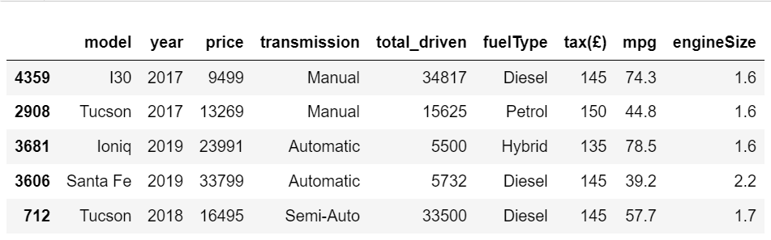
DATASET
The dataset used in this project contains information about used car sale prices in the UK. The variables included in the dataset are:
Model: The specific model or make of the car.
Year: The year in which the car was manufactured.
Price: The sale price of the used car.
Transmission: The type of transmission, such as manual or automatic.
Total driven : The total distance the car has traveled in miles.
Fuel Type: The type of fuel used by the car, such as petrol, diesel or electric.
Tax: The amount of tax payable for the car.
MPG: The miles per gallon fuel efficiency of the car.
Engine Size: The size of the car's engine.

Slide 6
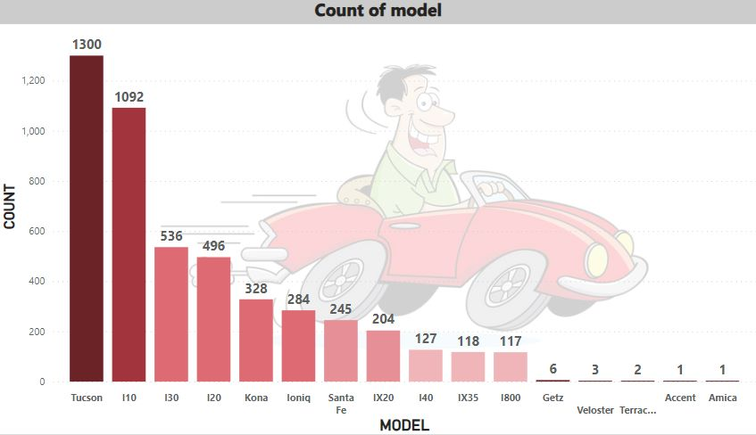
Count of Model by Model Name
The graph shows the distribution of car models in the given dataset
Showing the models in x-axis and the count of each model on the y-axis.
From the graph, we can observe that the top models with the highest counts are Tucson, I10, and I30, indicating their prevalence in the dataset.

Slide 7
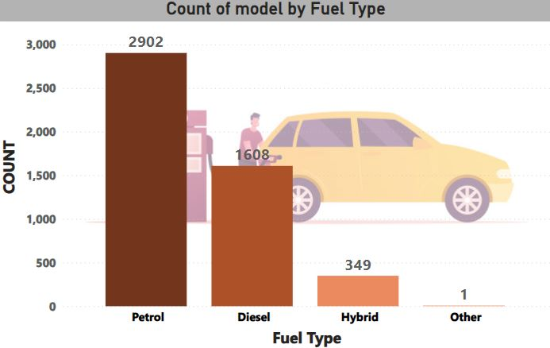
Count of Model by Fuel Type
The histogram shows the count of car models categorized by fuel types: petrol, diesel, hybrid, and others.
The y-axis represents the number of car models, while the x-axis represents the different fuel types.
The distribution shows that petrol has the highest count (2902), followed by diesel (1608), hybrid (349), and others (1).

Slide 8
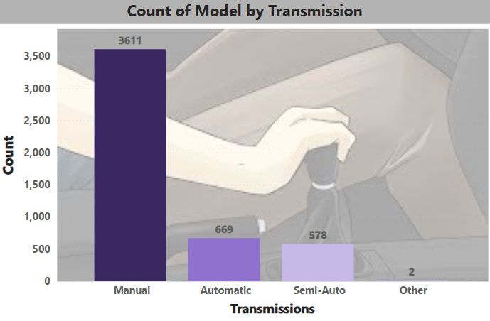
Count of Model by Transmission
1. The y-axis represents the number of models, while the x-axis represents the different transmission types.
2. The distribution reveals that the manual transmission has the highest count (3611), followed by automatic (669), semi-Auto (578), and others (2).
The histogram displays the count of car models categorized by different transmissions: manual, automatic, semi-Auto, and others.

Slide 9
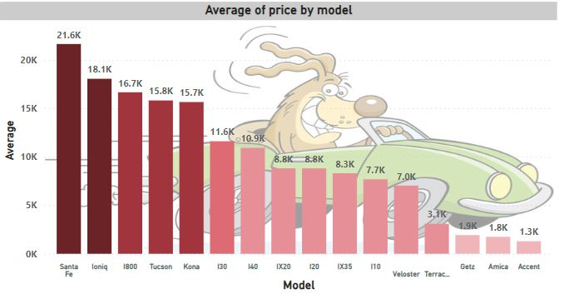
Average of Price By Model Name
This graph shows the Average price of the different Car Model including all the Factors
The distribution shows that Santa Fe has the highest Average Price among all is around(21.6k), followed by Ioniq, I800 and others.

Slide 10
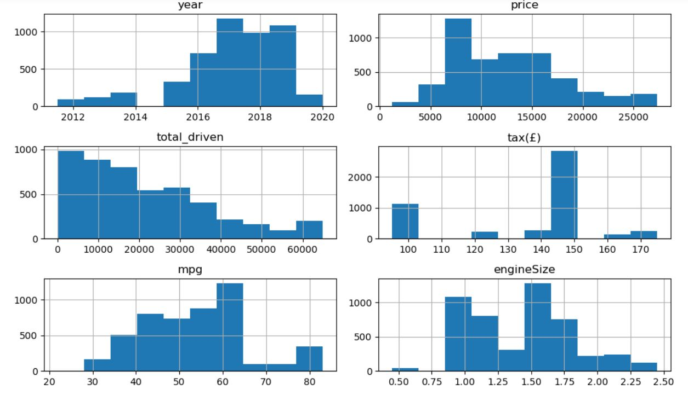
NUMERICAL DISTRIBUTION
The plot displays the distribution of each numerical variables in individual histogram, such as Year, Price, Total Driven, Tax(£), MPG, and Engine Size.
2. By examining the histograms, we can observe the frequency and range of values for each variable, providing insights into their distribution patterns and potential outliers.

Slide 11
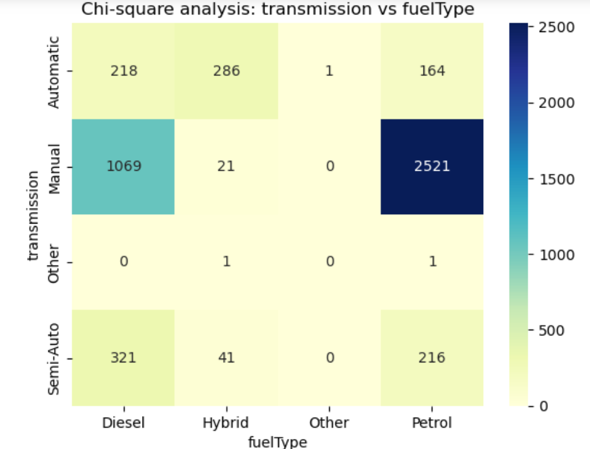
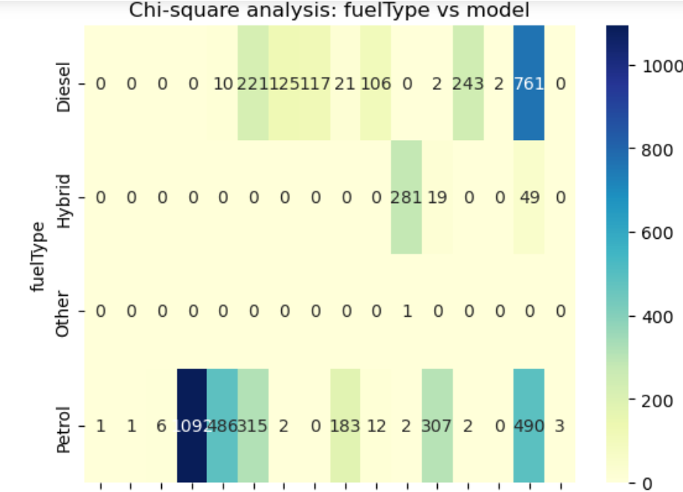
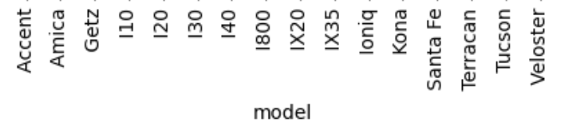
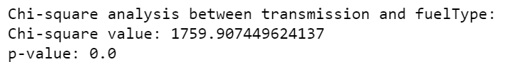
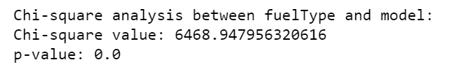
Relationship between transmission vs Fuel Type vs model
CHI-SQUARE ANALYSIS

Slide 12
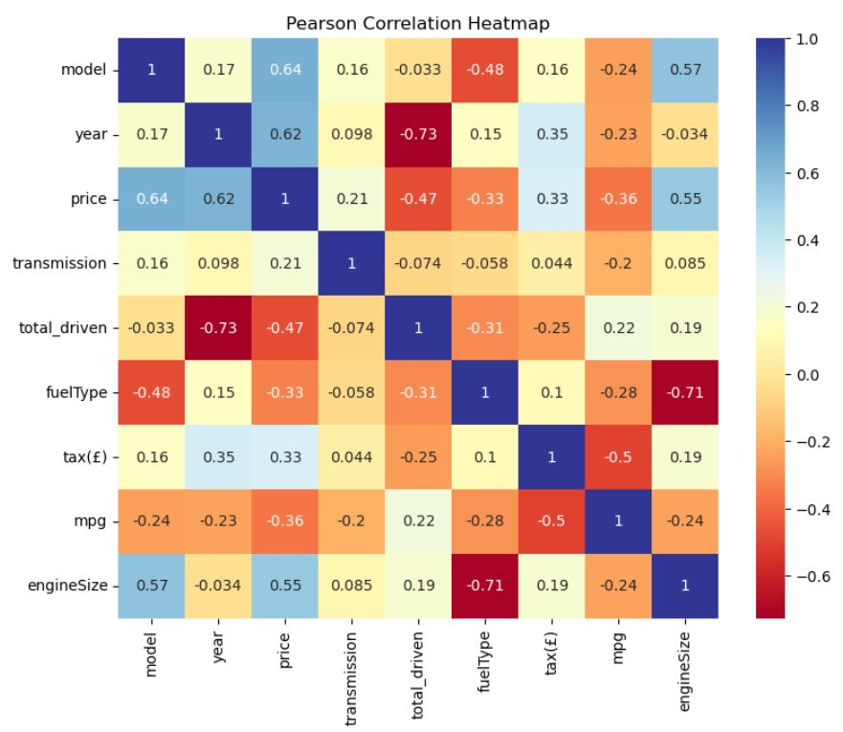
PEARSON CORRELATION
The Pearson correlation heat map reveals the strength of linear relationships between variables.
The price demonstrates a strong positive correlation with the Model, Engine size and year, while a weak correlation is observed with Total Driven, Fuel Type and mpg.

Slide 13
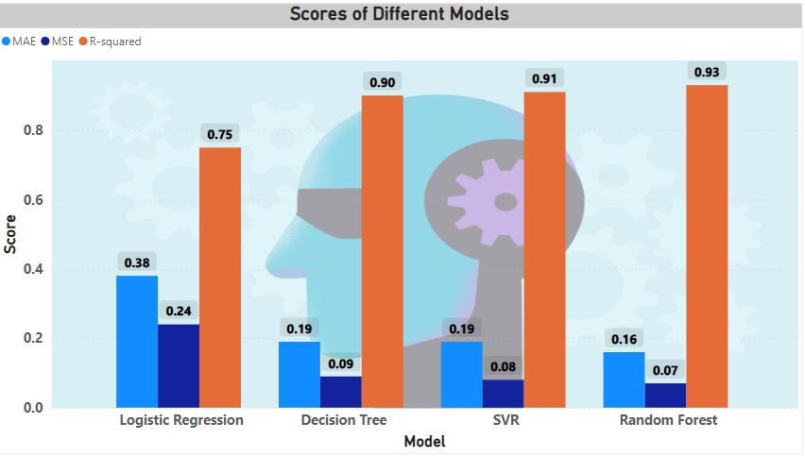
MODEL PERFORMANCE
The graph compares the performance of different models, including Linear Regression, Decision Tree, Random Forest, and SVR, based on evaluation metrics such as Mean Squared Error (MSE), Mean Absolute Error (MAE), and R-squared scores. 2. The Random Forest model shows the lowest MSE and MAE values, indicating better accuracy and precision in predicting the target variable. 3. With an R-squared score of 0.93, the Random Forest model demonstrates a strong correlation between the predicted and actual value
Performance of models evaluated and compared to identify the top-performing model

Slide 14
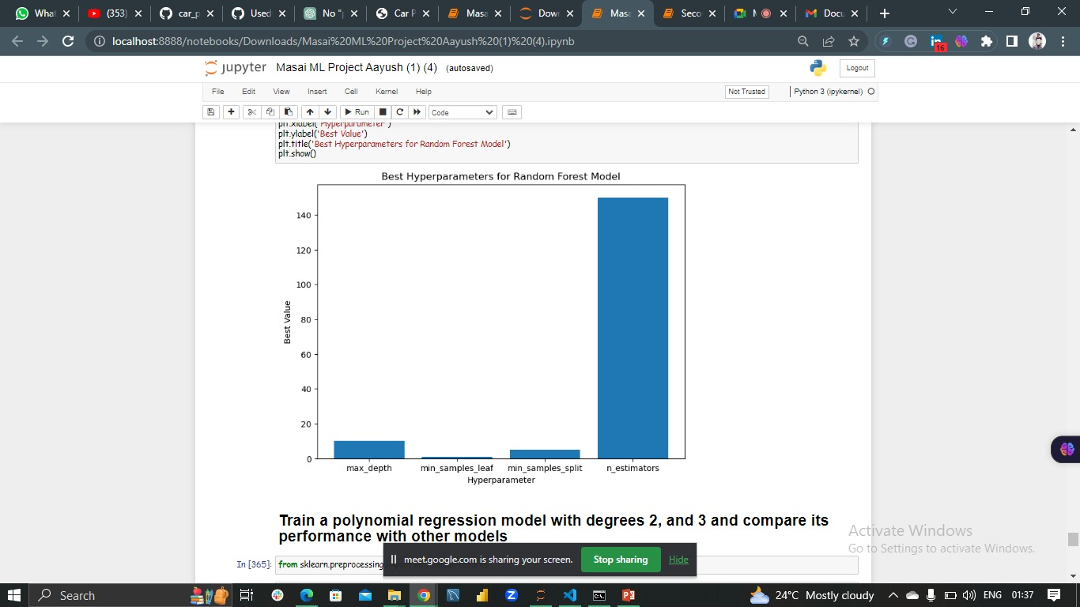
GRID SEARCH CV TUNING
The hyper parameter grid defines a set of values for key parameters in the Random Forest model.
2. The best hyper parameters for the Random Forest model were determined to be max_depth=10, min_samples_leaf=1, min_samples_split=5, and n_estimators=150, resulting in a mean cross-validation score of 0.9323.

Slide 15
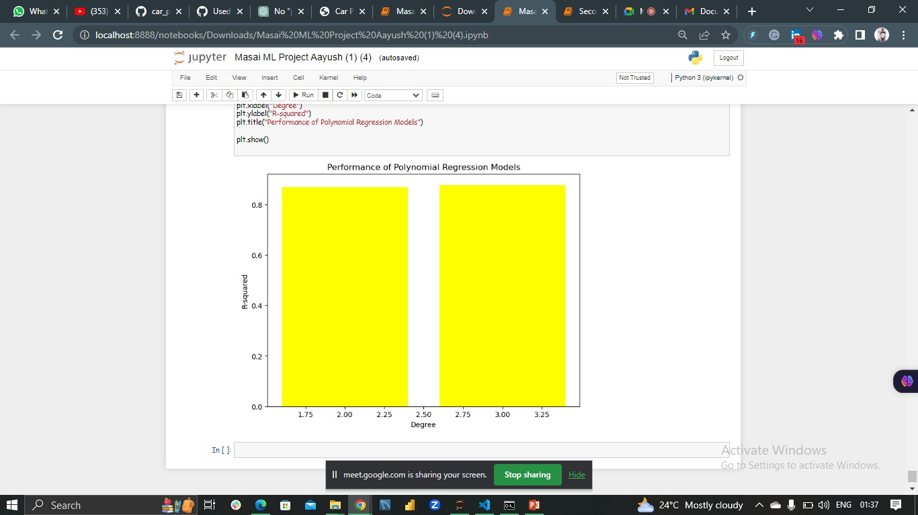
POLYNOMIAL REGRESSION MODEL
The KPI for the polynomial regression model is to compare its performance with other models. This can be done by evaluating metrics such as mean squared error (MSE), mean absolute error (MAE), and R-squared (R2) score, which indicate how well the model fits the data and predicts used car prices.

Slide 16
OBSERVATION
Error Distribution: After training our model, we analyzed the difference between the test and predicted values using a distribution plot. The errors followed a normal distribution with a mean close to zero. This indicates that our model's predictions are generally accurate, as the errors are minimal.
Scatter Plot Analysis: We plotted the test points against the predicted points using a scatter plot. The points aligned closely along the diagonal line, indicating a strong correlation between the predicted and actual values. This suggests that our model is effectively capturing the patterns and trends in the data.
Performance Metrics: We evaluated the performance of our model using metrics such as Root Mean Square Error (RMSE), R2 Score, and Mean Square Error (MSE). Our model achieved an RMSE of 1.36 and an MSE of 1.97 for the test and predicted test values. These metrics provide insights into the accuracy and precision of our model's predictions.
Accuracy Score: While accuracy score is typically used for classification tasks, we adapted it to assess the accuracy of our regression model. By setting a cutoff based on MSE, we classified predictions as either correct or incorrect. Our model achieved an accuracy score of 93.4%, indicating its effectiveness in predicting used car prices.

Slide 17
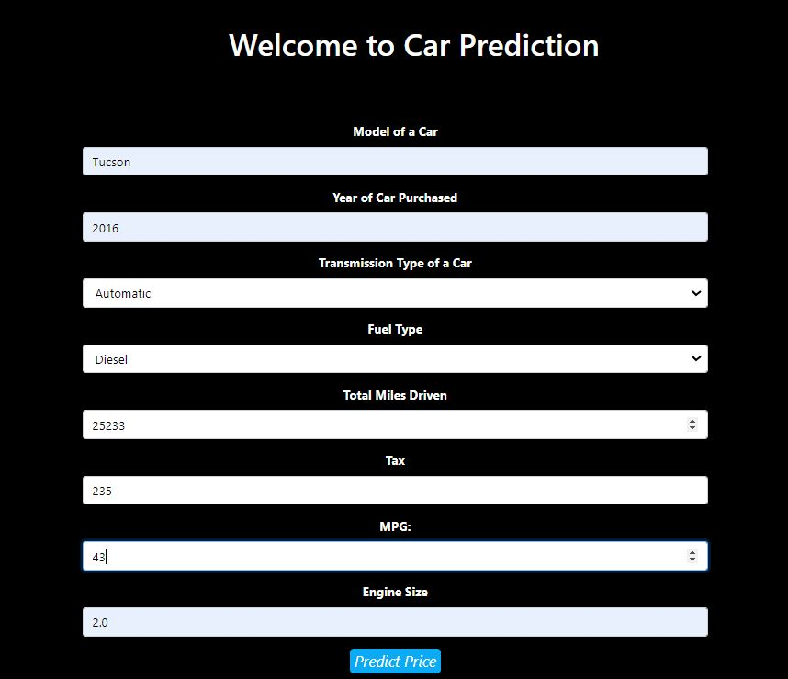

RESULT
The results are demonstrated in html page. The features are entered and the selling price is calculated in Euro.
FEATURES
Model of a Car
Year of Car Purchased
Transmission
Fuel Type
Total miles Driven
Tax
MPG
Engine Size
: Tucson
: 2016
: Automatic
: Diesel
: 25233
: 235
: 43.5
: 2.0
PREDICTED PRICE
The price predicted is 14499 Euro

Slide 18

CHALLENGES
Transforming categorical values and removing unnecessary features for regression compatibility.
Finding the best regression algorithm and dealing with challenges in gridsearchCV for hyper parameter tuning.
Identifying influential features using techniques like Pearson coefficient correlation and extra tree regressor.
Learning HTML from scratch to develop a webpage showcasing the model's workings.

Slide 19




THANK YOU ☺

